Slide 1
Presentation to the Broome Economic Summit 2012
By Mayor Ian Carpenter
Chairman of the WA Regional Capitals Alliance

Slide 2
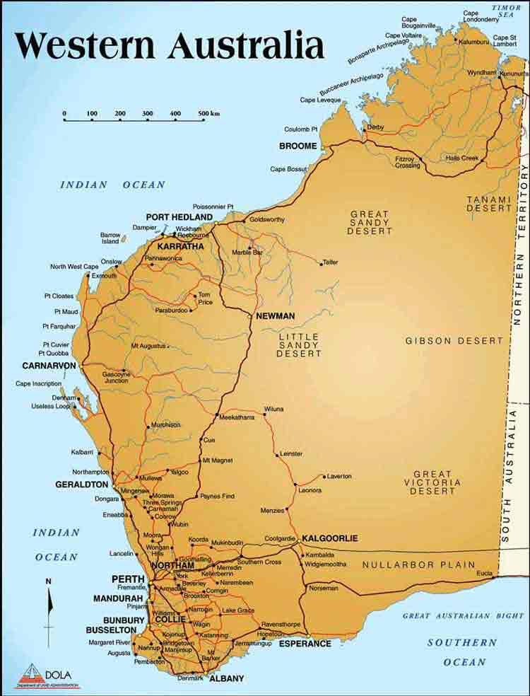
Who are we?
Based on the major regional city centres
(e.g. the ‘regional capital’)
City which have a clear role in being the focal point and capital for a region

Slide 3
What are we about?
Collaboration between the Cities – our aim is to move past competing with each other and ensure we get a collective and supportive approach to securing better outcomes
Partnering with both the State and Commonwealth Government
Promoting our capacity - our aim is to highlight and increase aware in opportunities for lifestyle, investment and locating in our respecting communities

Slide 4
Our Objectives
The Alliance cities :
will work to develop a collaborative framework to engage with an partner with both the Western Australian and Australian Governments;
will work collaboratively to achieve the future sustainable development of the State of Western Australia;
will work towards being accepted as a legitimate and respected grouping within the arrangements resulting from the current Local Government Structural Reform process;
will ensure that the emergence of the Alliance occurs in a balanced fashion, recognising the infrastructure needs and associated funding requirements of sub-regional centres in their hinterlands;

Slide 5
Our Objectives /2...
The Alliance cities :
will work towards a framework to evolve into fully fledged alternatives to the Perth metropolitan area as locations for the growing population of the State;
will to actively participate in State Population Policy development to ensure the State’s future population growth and its associated demands for social, economic and environmental amenity are distributed in a sustainable fashion. The Alliance believes that the realistic target is for 50% of projected population growth to occur in regional areas, with 25%a to be located in regional cities; and
are positioned and resourced to represent the interests of its member and to enable synergies at operational and strategic levels.

Slide 6
What aren’t we about?
Lobbying – we are not a lobbying organisation – instead our aim is to work with groups to bring mutually beneficial outcomes
Competitor or replacement to WALGA – all cities are active members of WALGA and support working through WALGA. Our Alliance is specifically to deal with issues affecting our group as major regional (capital) centres.
Not a rebirth of CUCA - We are not a rebirth of the Country Urban Councils Association (CUCA)

Slide 7
Key initiatives
Planning or Future – developing consistent Regional Growth Plans which function as Local Planning Strategies and new contemporary performance based Town Planning Schemes
Promoting our Cities – utilising the Commonwealth’s $11.5M Promoting Regional Living Program
UWA Research Partnering –an innovative best practice research, modelling and policy development program headed up by a new Winthrop Professor for Regional Cities
Equality for Lifestyle – focusing on the provision of culture & arts infrastructure and services focusing on Performing Theatres, Museums, Art Galleries and Libraries
Promoting Regional Policy – developing issues and discussion papers focused on encouraging the State to adopt a WA Regionalisation Strategy

Slide 8
Planning our Future
Projects seeks to utilise the existing State Planning framework
Key elements-
  Regional Growth Plan which will comply as a WAPC approved Local planning Strategy
  Contemporary performance based Town Planning Schemes consistently applied to all regional cities
Genuine opportunity to align this initiative with any planning proposed for the SuperTowns initiative

Slide 9
Promoting our Cities
Implemented new branding and a new website
www.waregionalcapitals.com.au
Reviewing options to undertake an Evocities style marketing campaign to attract metropolitan and interstate workers to move to WARCA cities
Promote investment by the private sector in WARCA cities
Promote the viability of considering a WARCA city as an alternate to Perth (or an eastern State capital)

Slide 10
UWA Research Partnering
A unique model of research partnering
$750,000 committed by WARCA members and over $800,000 by UWA
A new Winthrop Professor of Regional Cities and 4 PhD students
The partnership’s specific objectives are:
  • Analysis and modelling of demographic, social and economic indicators;
  • The definition of current and future service and infrastructure needs and standard;
  • Collaboration on the analysis of strategic planning needs, and in the development of responses;
  • Engagement in research and strategy related to the distribution of population and economic activity within the broader context of Western Australia;
  • Development education and research capacity in areas relevant to the needs of regional cities.

Slide 11
Equality of Lifestyle
Focus on achieving lifestyle improvements and equivalence to Perth
Targeting Museums, Art Galleries, Performing Theatres and Libraries
Working closely with Dept. of Culture & Arts and the Dept. of Regional Development & Lands
Options for consideration of reviewing levels of responsibility:-
  Local government – local community and catchment need
  State Government / consolidated revenue - Regional need
  State Government / Royalties for region - Perth equivalence
Key issues include developing a consistent standard to apply to all cities and a framework for the development/enhance of facilities and the maintenance/operating of facilities

Slide 12
Promoting Regional Policy
Group has been working on a draft discussion paper on a possible WA Regionalisation Strategy
The paper covers the following policy initiative
  Western Australian Regionalisation Policy
  Regional Living Pathways
  Regional Devolution Strategy
  Strengthening Regional Business
  Planning Regional Cities
  Building Regional Industry
This paper is not intended to be about what WARCA want to do – but rather as a basis for the State Government to adopt and apply
We would like to start a serious and broad dialogue with Government, the community and Industry to progress the development of a WA Regionalisation Strategy

Slide 13

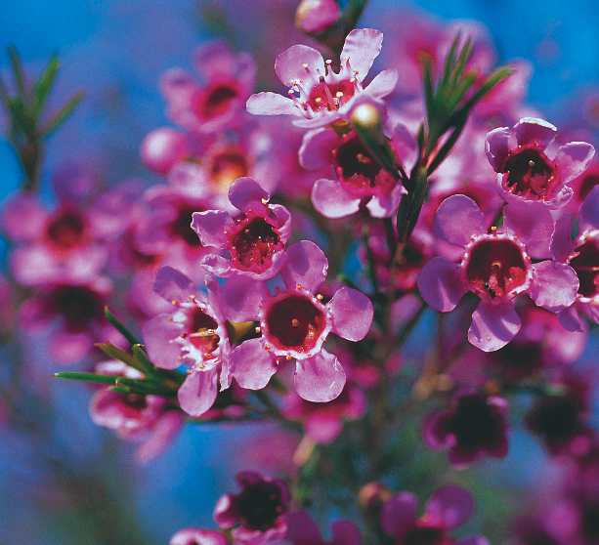
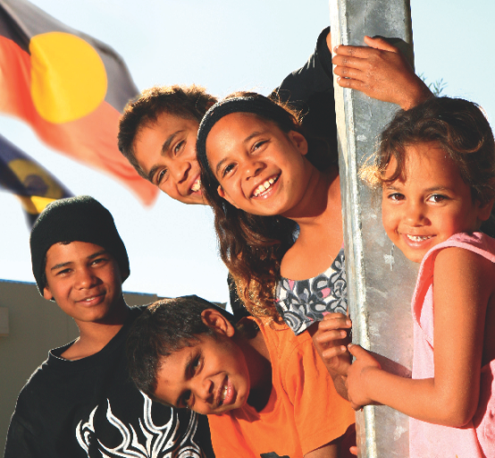

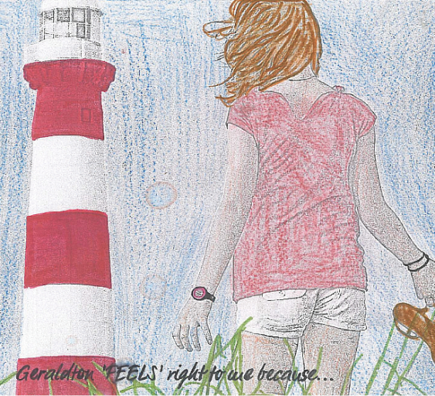
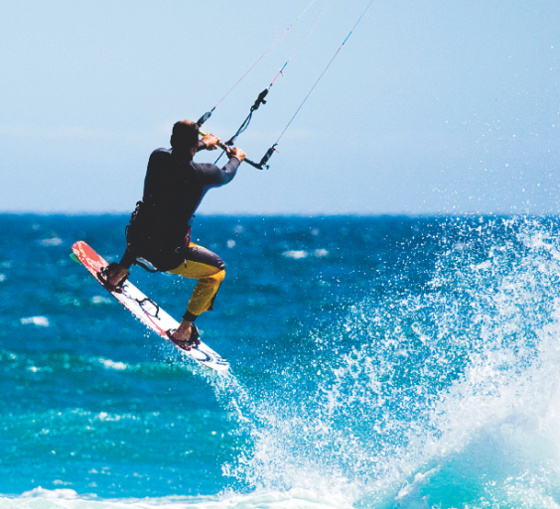


The International Awards for Liveable Communities 2011

Slide 14
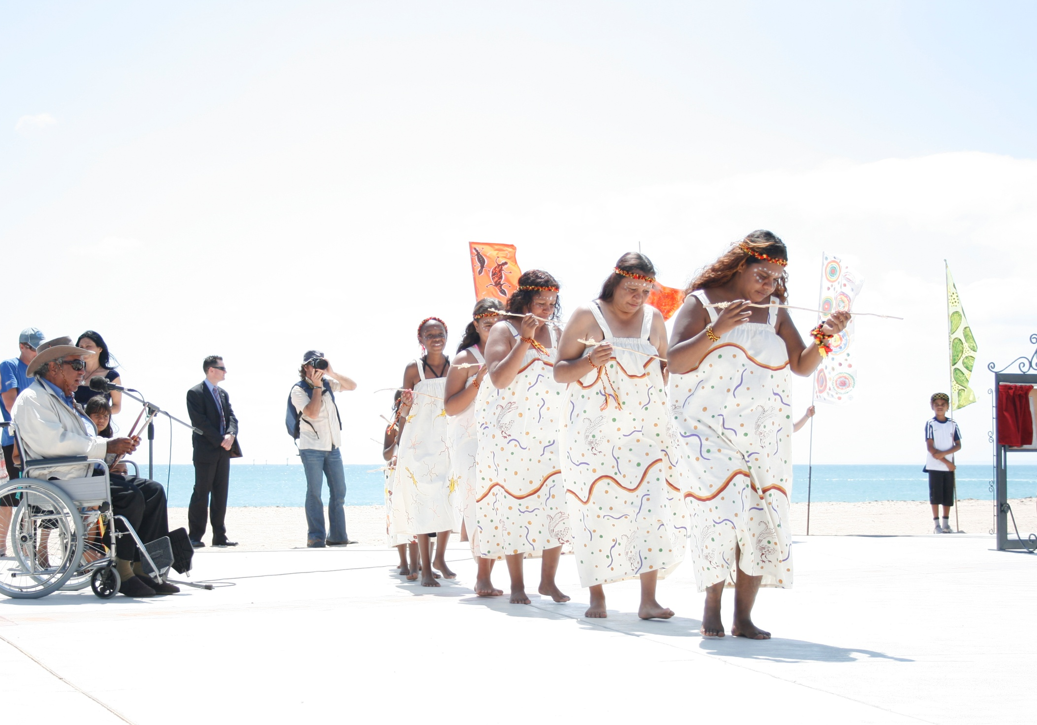
Notes:
It is with great pleasure that we present the Australian regional City of Greater Geraldton to you.
We are honoured to be a finalist in the International Awards for Liveable Communities. The Awards encourage best practice, innovation and leadership in the creation of vibrant and sustainable communities. These are the goals that inspire us in our work for the people of Greater Geraldton.
My name is Ian Carpenter, the Mayor of Greater Geraldton
It is customary for the City of Greater Geraldton to acknowledge the traditional custodians of land at the start of formal gatherings and events as a sign of our respect for the Aboriginal community. It is with great pleasure that I will now play a short message from elders from the Amangu and Naaguja people.

Slide 15
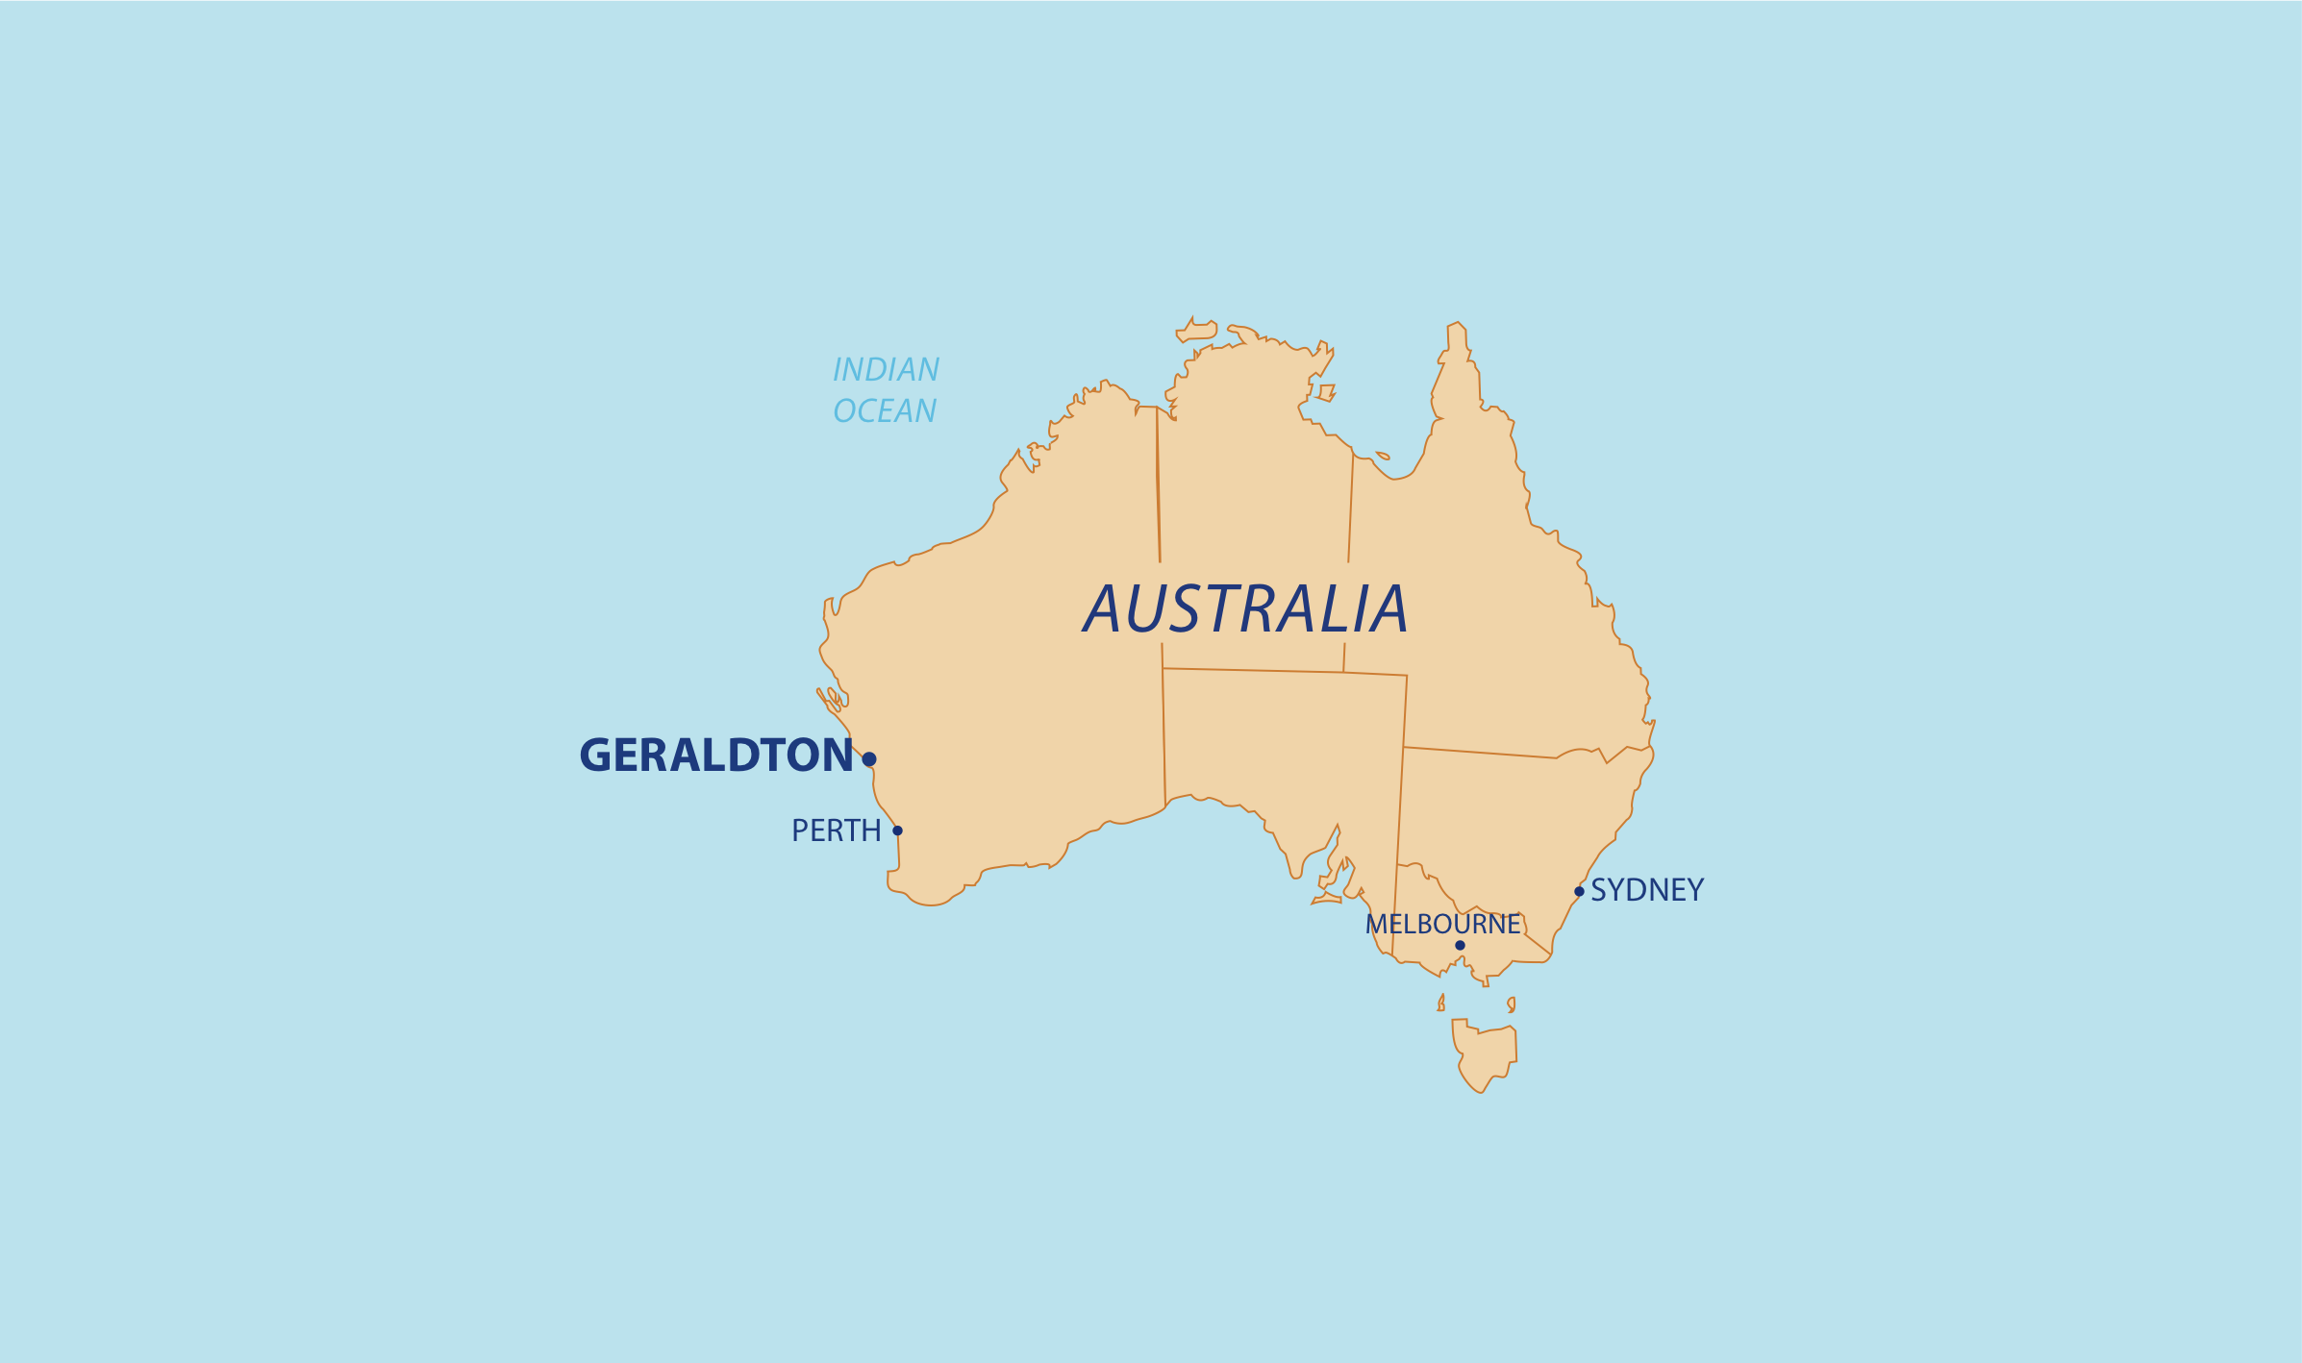

Notes:
Australia is a vast island continent. The interior of the country is mostly flat, barren and sparsely populated, with 80% of the people living on the narrow, fertile and cooler coastal environment.
Despite its relatively small population, Australia has the 14th biggest economy in the world. Its GDP is approximately $1.3 trillion USD, dominated by its service sector, with agriculture and mining accounting for 57% of the national exports.
Greater Geraldton is in Western Australia which has a population of over 2 million, mostly made up of numerous waves of immigration from 200 countries and a small Indigenous population. Greater Geraldton has 38,000 citizens and we are expecting to double our population over the next 10 years. We estimate that our land use carrying capacity is around 230,000 people.
Our story begins with the traditional custodians of our land, the Yamatji people, who have 40,000 years of rich cultural and spiritual connections across the region. Greater Geraldton has a fascinating maritime heritage which began with European contact in the 17th Century. The first European townsites at Geraldton and Greenough were established over 150 years ago.
Greater Geraldton is the one of the main regional cities of Western Australia, with fishing and agriculture (wheat and sheep) being the traditional economic backbone of the region’s economy. Both these industries are in decline due to collapsing fish stocks and drought. In more recent times, mining of vast mineral resources, high technology including world class radio astronomy and alternative energy opportunities have emerged as the new economic drivers.
Capitalising on these economic opportunities will see significant changes to our regional economy, a dramatic increase in population and a changed demography profile. At the same time the City is facing significant challenges associated with climate change -reduced rainfall, higher temperatures and rising sea levels- as well as the problem of peak oil which will affect our dependency on conventional transport that has played such a crucial role in overcoming our remoteness. The likely speed of population growth is a cause of concern for some of our current citizens who prefer to retain the “country feel and lifestyle” and are fearful of the potential damage to the environment, congestion and more impersonal crowded living.

Slide 16
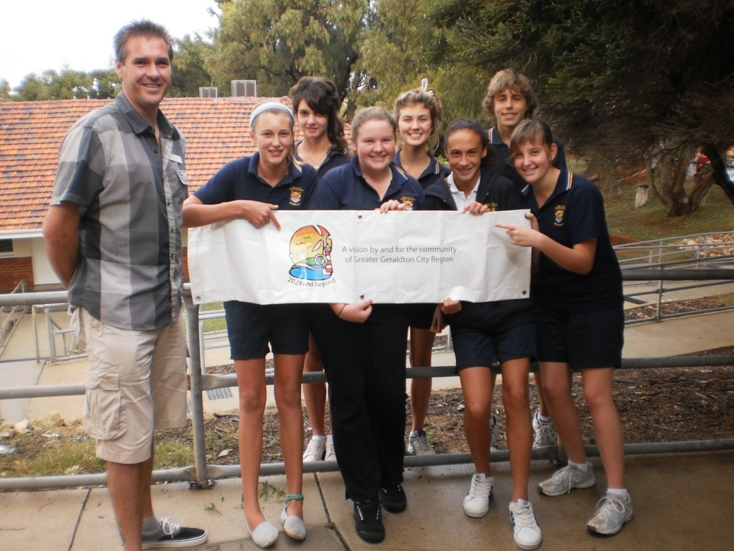
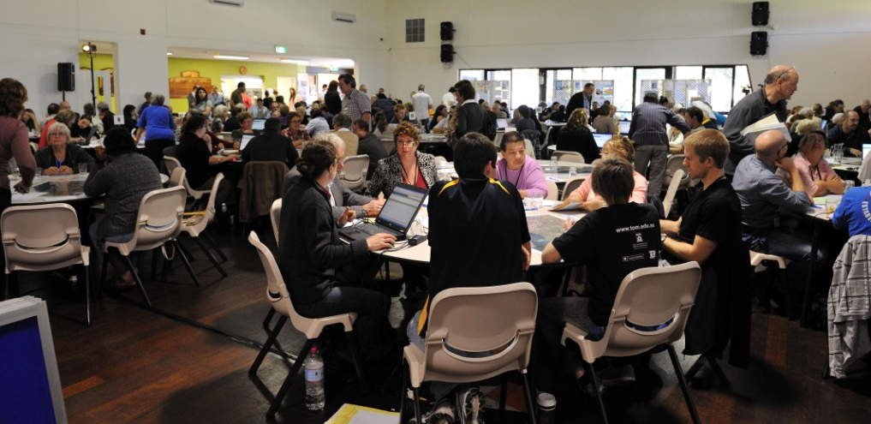

Notes:
The challenge for our civic leaders is to engage the community in the planning of our growth and to ensure that we remain resilient and become a sustainable and liveable city. What sets us apart, we believe is our commitment to the innovative 2029 and Beyond initiative, which is the centrepiece strategy for the City’s transformation. 2029 and Beyond is a long-term strategy that involves the community – ordinary citizens, all levels of government, industry and the non-government sector in participatory governance. Together we will undertake collaborative problem solving and decision making. 2029 and Beyond has been designed to fulfil the citizens’ vision for a smart, sustainable city where a sense of community matters for current and future generations.

Slide 17
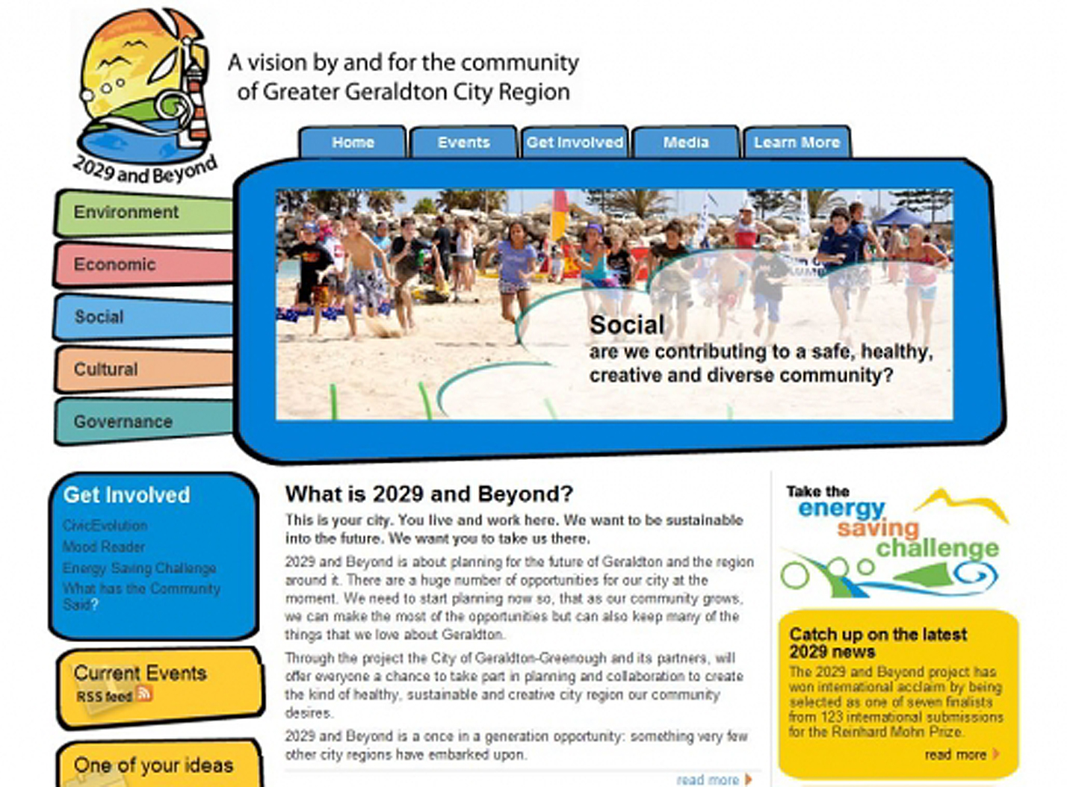
Notes:
Our citizens place a very high value on the strong sense of community, civic engagement and the benefits of living within a diverse and culturally rich community. In our City over 7,500 people volunteer their time to support groups or organisations that enhance the well-being of the community and its environment.
The City has sought to build on this community spirit and to take it further. Our goal is to implement participative governance as the usual way for the City to plan and take actions towards sustainable future. Participative governance involves ordinary citizens, all levels of government, industry and the non-government sector learning together and collaborating to produce a blueprint for the future of the City.
To do this the City is leading a long-term innovative strategy called 2029 and Beyond. Not only is there a high degree of participation, but the way people participate is also very important. Citizens have diverse opportunities to take part in serious, in-depth, mutually respectful discussion, exploring and explaining their reasons for the positions they take, considering and carefully weighing options, and cooperating to arrive at decisions that reflect a coherent voice. Importantly, everyday people, including those who don’t usually participate in civic decision-making, are playing an integral role in policy development and decision-making.
The work we are doing through 2029 and Beyond has been recognised internationally by the Bertelsmann Foundation in their global Reinhard Mohn Prize. Of the 123 entries from 23 countries in 2010, our project was awarded 5th place. Here is a short film made for our submission.

Slide 18


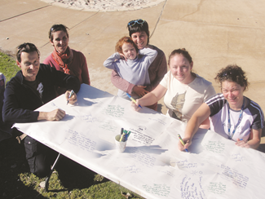
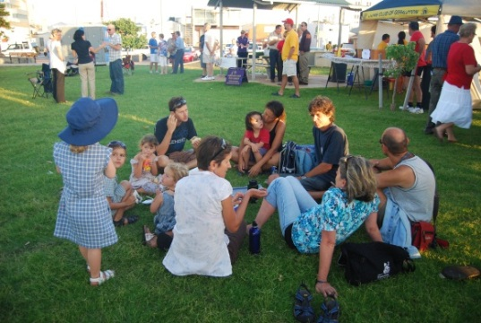
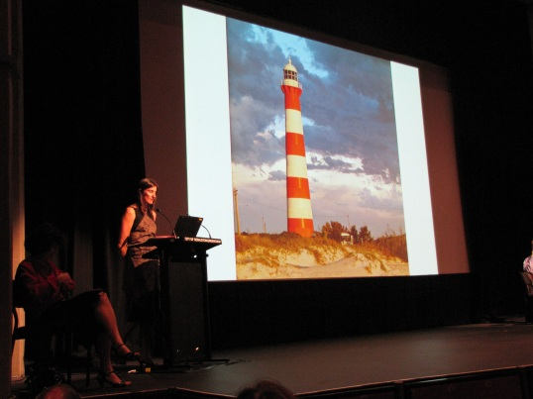
2029 and Beyond
Partnerships
Notes:
CUSP (Curtin University Sustainability Policy Institute) led by Prof Peter Newman
Prof Janette Hartz-Karp
University of WA
Lotterywest
Mid West Development Commission
Main Roads
Combined Universities Centre for Rural Health
Mid West Aboriginal Organisations Alliance
Department of Planning

Slide 19
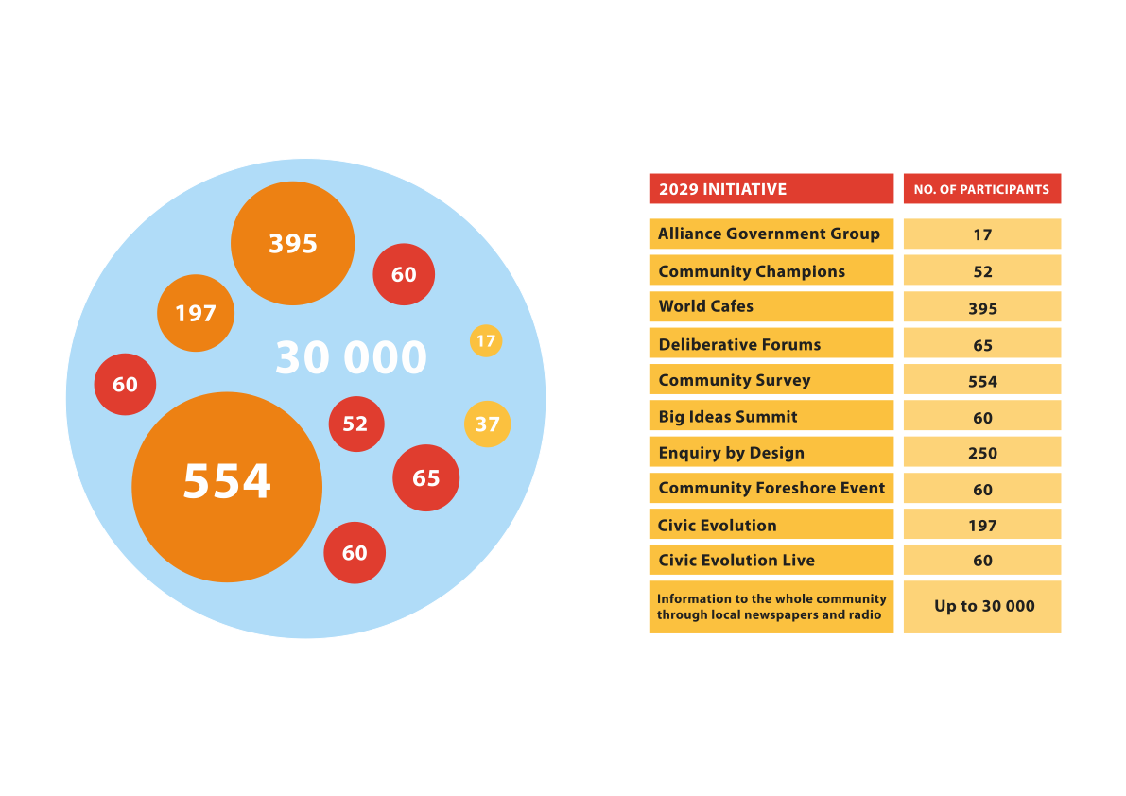
Notes:
I’d like to highlight our achievements to date. These have included
the implementation of a new form of participatory governance, ‘the Alliance Governance Group’ (community, industry and government) to oversee and help implement outcomes of 2029;
‘community champions’ who initiative and engage the community in conversations that matter;
a strong alliance with the media, in particular the widely read local newspaper, to foster informed dialogue and involvement;
new connections with Indigenous and multicultural groups,
an interactive website, the implementation of innovative online deliberation, ‘CivicEvolution’ to encourage the community to develop ideas into proposals; and
small and large scale face-to-face deliberations to facilitate joint problem solving and collaborative action.
Participation to date has been very encouraging and we believe that we are building stronger civic mindfulness, democratic attitudes and skills within the City. This was evidenced in the recent Enquiry by Design where 250 community members participated in the three day deliberative process to design the future of our City.
Through 2029 and Beyond we will continue to create new forums where people can talk through their ideas and access assistance with developing them, including development of the entrepreneurial spirit.

Slide 20
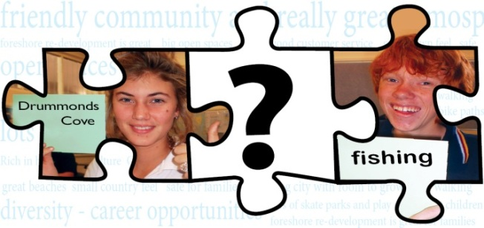

Deliberative Process
World Cafés Reports, Deliberative Survey, Forum Reports
Analysis and collation
Community Directions Forward
The Geraldton Feel – Conversation Cafés and Competition
Designing our City Forum
Statutory Planning Documents and Community Action Plan
Will inform further deliberations becoming more holistic and clear
Notes:
ANDREA
Copies of various reports produced in folders for judging panel – process of gradual building of knowledge and understanding. This is not a ‘once off event’ - it is a new way of working with community and becoming a more deliberative community

Slide 21
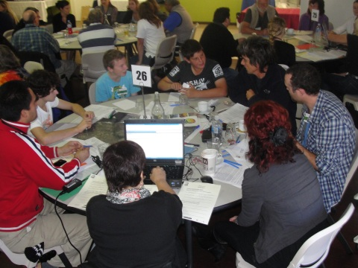
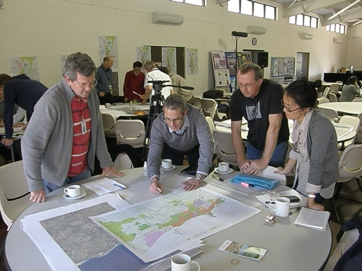
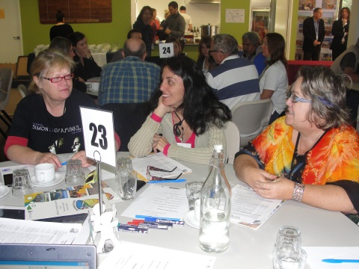
Deliberative Process
Designing Our City
Community members working with an expert team to:
Define planning principles;
Values;
Legacy;
Scenarios for growth;
Notes:
PHIL
Brief outline of regional planning in WA
Over 250 people participated.
100 self selected – worked hard to get youth, indigenous and multicultural community involved (forum participants were representative of the demographics of the Greater Geraldton City region)
100 random selected
50 key stakeholder agencies invited
Random seating to ensure a variety of views on each table.
Highly interactive; innovative use of technology;
immediate reports back to the community
Outputs to inform Strategic/Statutory Planning and
a Community Action Plan
Day 2 a select Multi-Disciplinary Team (MDT) of experts will synthesised outcomes from Day1, and developed a suite of scenarios and principles to guide future planning which were presented back to the community and key stakeholders in the evening for comment. - the evening session with the community around 150 people returned and using station rounds commented on the six planning scenarios that were presented by the MDT
Day 3 the MDT will considered the feedback on the initial presentation and refined ideas, which presented back to the community and key stakeholders in the final evening for comment. Used Open Space Technology
An important step in establishing the direction for the future growth of Geraldton and the surrounding area, and will help to ensure that any future development is better coordinated to deliver a place that is more sustainable and serves the future needs of the community.
Output
Will feed into statutory planning documents
Community Action Plan – multi agency plan that responds to community aspirations
101 – small steps

Slide 22
http://youtu.be/dNLuh_Seg5I

Slide 23
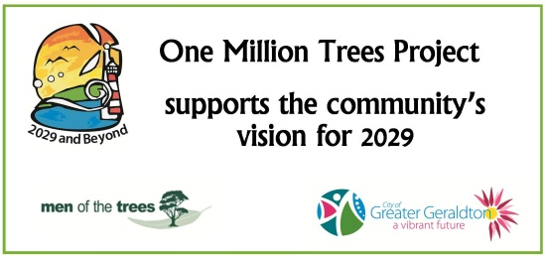

2029 and Beyond
A parallel and iterative process
2029 Key Themes & Directions
Forum Results
Local Planning Strategy
Town Planning Scheme
Other CGG Plans, Policies & Strategies
2029 Community Action Plan Development
Ongoing Implementation Monitoring & Reporting
Notes:
World does not stop while we undertake the deliberative process– stakeholders still want guidance and decisions;
People also want to see Real Action – quick wins have been identified – MILLION TREES PROJECT/YOUTH RESOURCE CENTRE/HERITAGE TRAILS /
Deliberative process, strategy development
and real ACTION -
FLEXIBLE AND DYNAMIC – AN ABSOLUTE NECESSITY
Investibility Model
Social and Creative City Plan
City Vibrancy Study
Commercial Activity Centres Strategy
Land Use, Transport Strategic Model
Origin Destination Survey (For Land Use & Traffic Model)
Residential & Rural Land Strategy
Public Open Space Strategy
Precinct Planning Strategy
Community Action Plan
101 Small Steps
World Café Priorities

Slide 24
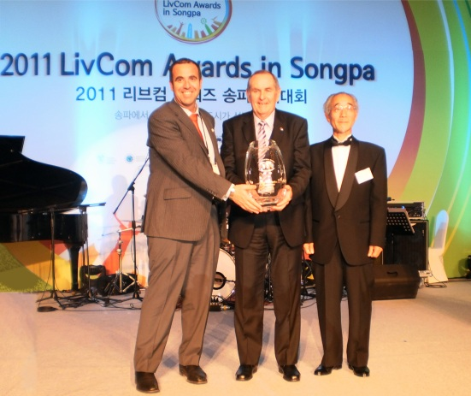
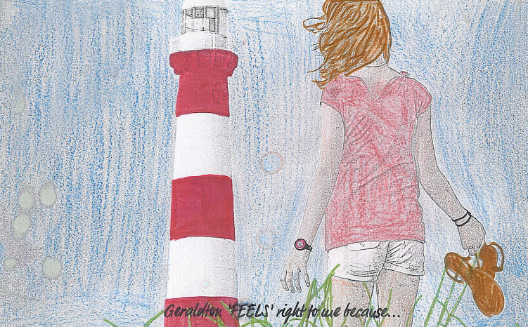
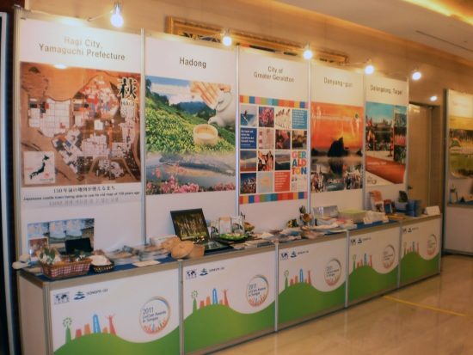
International Recognition
2011 International Liveable Communities Award
“LivCom”
Notes:
“The LivCom Awards were launched in 1997 and are endorsed by the United Nations Environment Programme, (UNEP). The LivCom Awards is the World’s only Awards Competition focussing on International Best Practice regarding the management of the local environment. The objective of LivCom is to develop and share International Best Practice, with the further objective of improving the quality of life of individual citizens through the creation of ‘liveable communities’.
Develop and share International Best Practice
Improving the quality of life of individual citizens through the creation of ‘liveable communities’.
The City entered Category B (population 20,001 – 75,000) of the Whole City section for which the submission addressed the following criteria:
1. Enchancement of the Natural and Built Landscapes;
2. Arts, Culture and Heritage;
3. Environmental Best Practices;
4. Community Participation and Empowerment;
5. Healthy Lifestyle; and
6. Strategic Planning.
Other shortlisted cities:
• Anping District, Taiwan, Republic of China;
• Chrudim, Czech Republic;
• Dalongdong, Tapei, Republic of China;
• Danyang-gun, Korea;
• Hadong Gun, Korea;
• Hagi City, Japan;
• Houbi District, Taiwan, Republic of China;
• Jihlava, Czech Republic;
• Kladno, Czech Republic;
• Mandurah, Australia;
• Pfaffenhofen an der Ilm, Germany;
• Seocheon County, Korea;
• Tabor, Czech Republic;
• Utena, Lithuania; and
• Xinqiao Town, Jiangyin City, PR China.
finals held in Songpa, South Korea from the 27 October to 31 October. • the overall category World Winner for Community Participation and Engagement

Slide 25
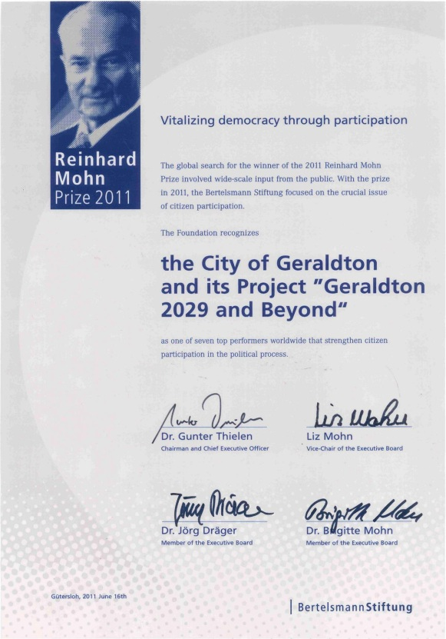
Reinhard Mohn Prize 2011
City of Greater Geraldton
5th Place
123 Projects
36 Countries
Notes:
I’d like to highlight our achievements to date. These have included
the implementation of a new form of participatory governance, ‘the Alliance Governance Group’ (community, industry and government) to oversee and help implement outcomes of 2029;
‘community champions’ who initiative and engage the community in conversations that matter;
a strong alliance with the media, in particular the widely read local newspaper, to foster informed dialogue and involvement;
new connections with Indigenous and multicultural groups,
an interactive website, the implementation of innovative online deliberation, ‘CivicEvolution’ to encourage the community to develop ideas into proposals; and
small and large scale face-to-face deliberations to facilitate joint problem solving and collaborative action.
Participation to date has been very encouraging and we believe that we are building stronger civic mindfulness, democratic attitudes and skills within the City. This was evidenced in the recent Enquiry by Design where 250 community members participated in the three day deliberative process to design the future of our City.
Through 2029 and Beyond we will continue to create new forums where people can talk through their ideas and access assistance with developing them, including development of the entrepreneurial spirit.

Slide 26
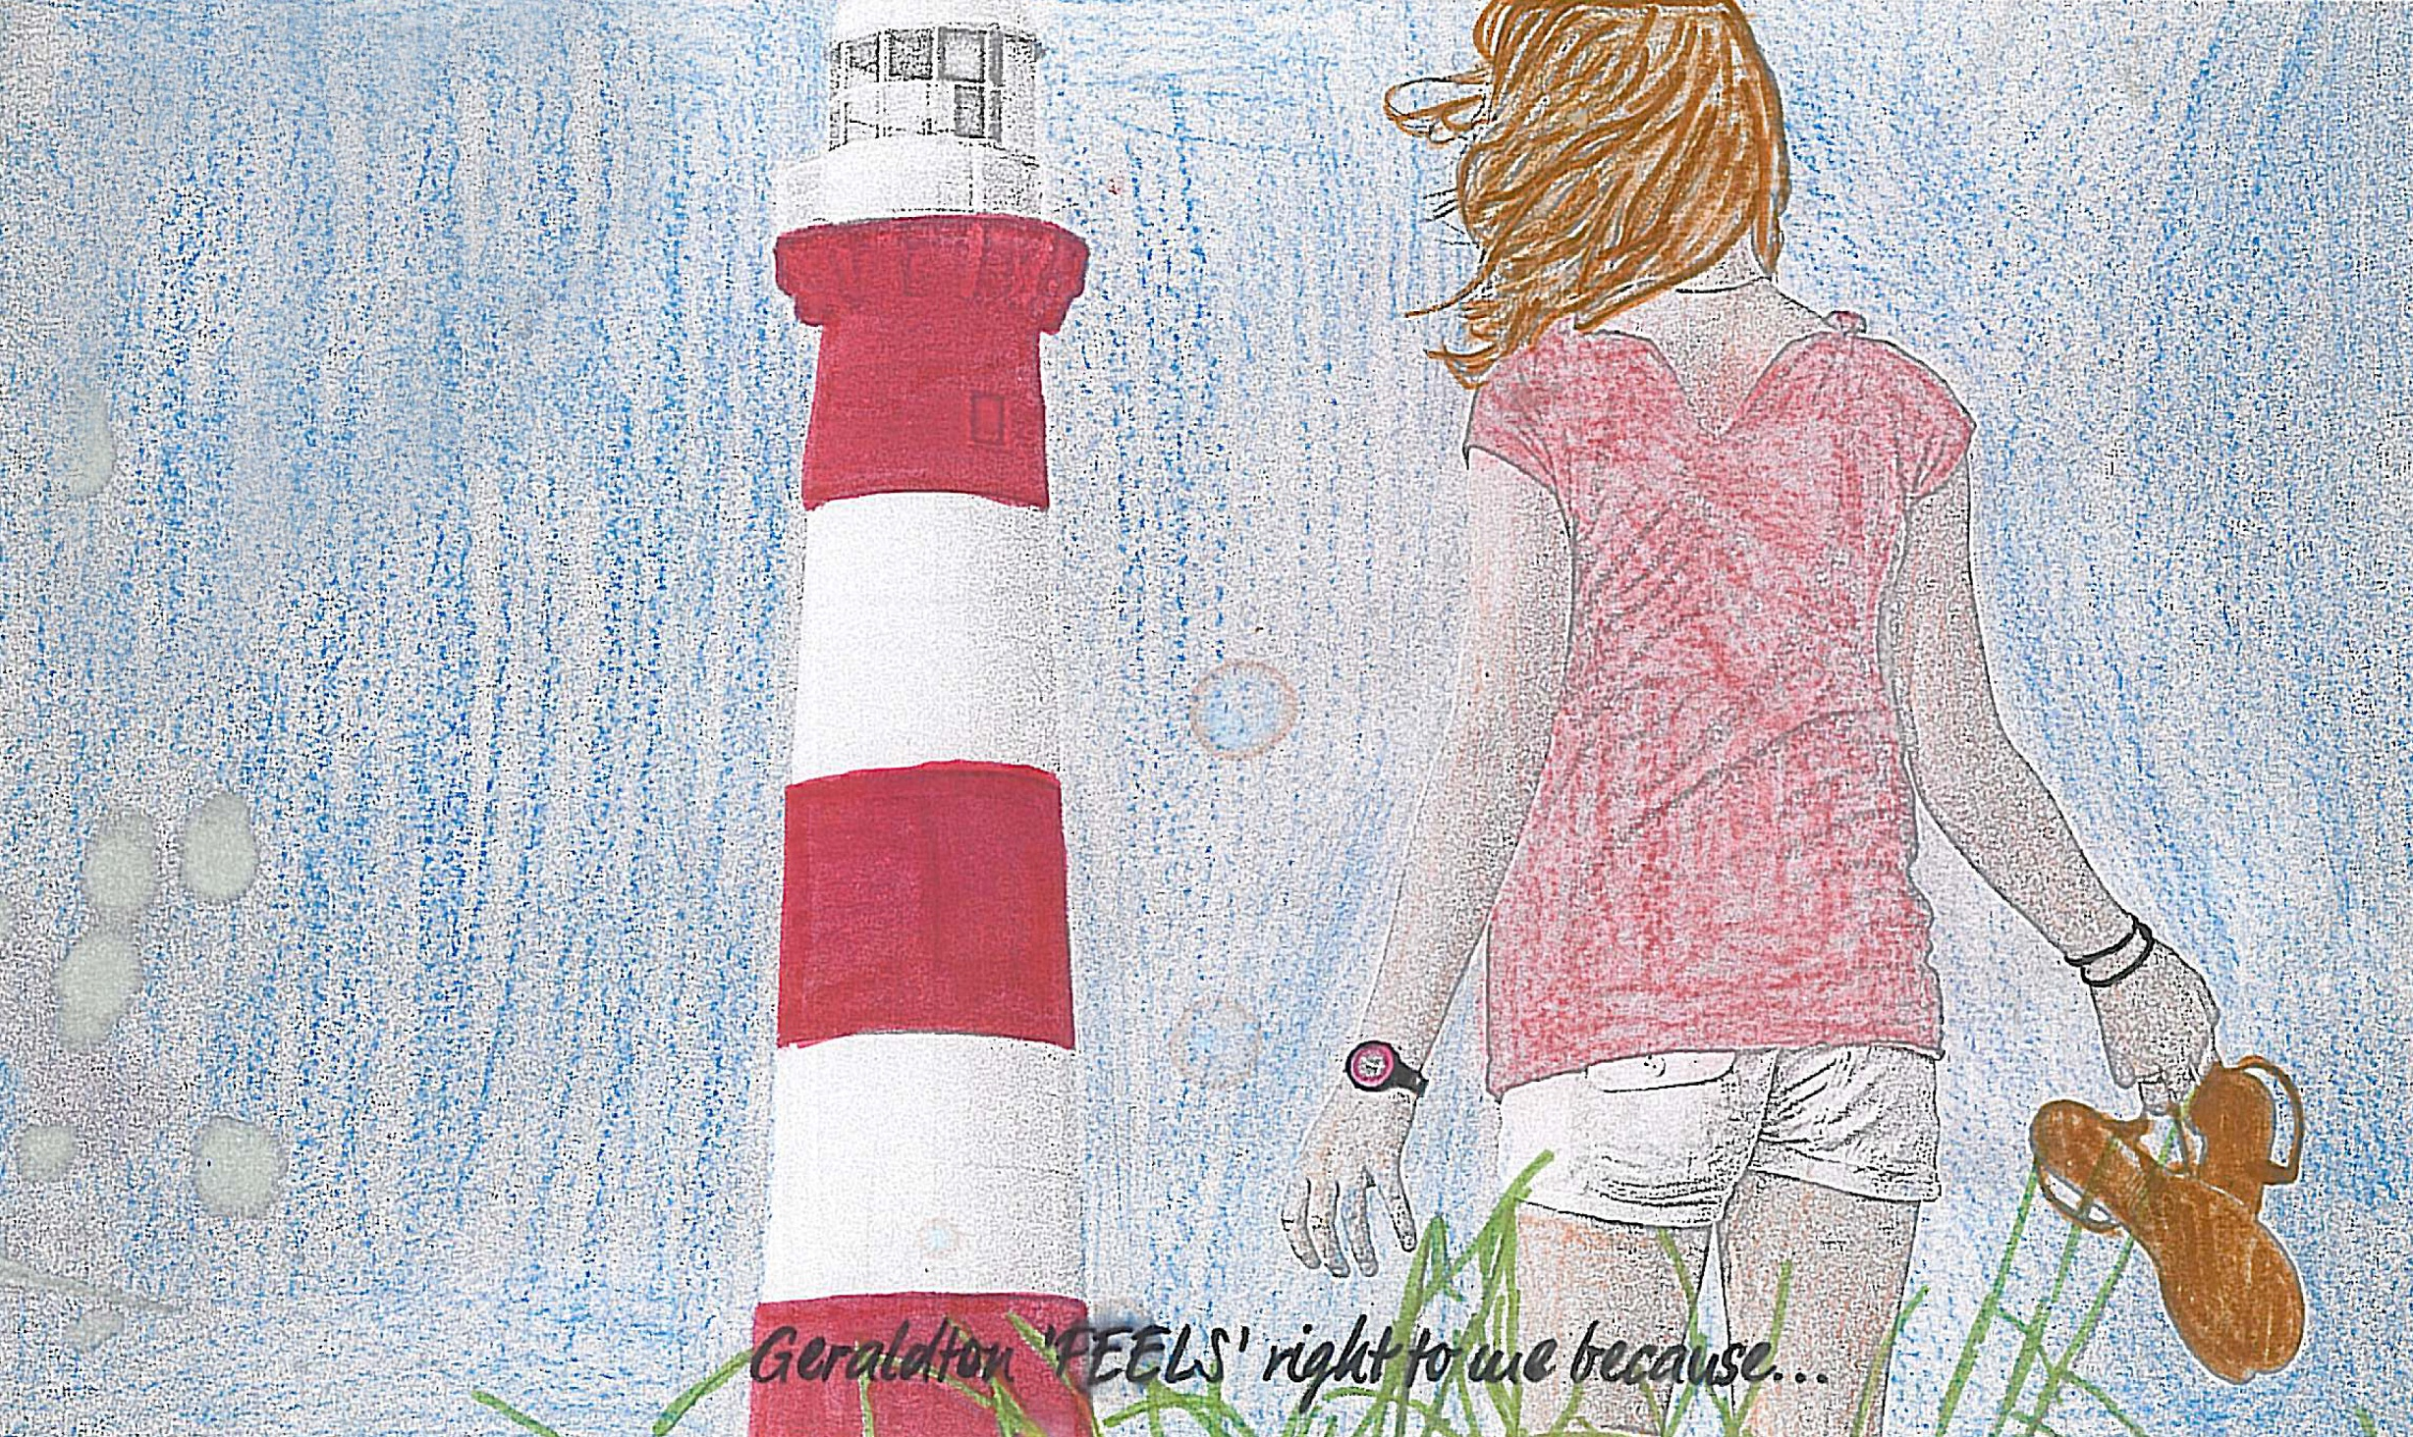

Notes:
Thank you once again for the opportunity to present our City at these Awards
We are immensely proud of what we have achieved so far but do not underestimate the challenges ahead to become one of the world’s best sustainable and liveable regional community
We know that turning our vision into a reality over the next 50 years will take intelligence, commitment, effort and leadership. It also requires recognition that the world is constantly evolving and we will have to modify this vision over time.
We will work to ensure that the City of Greater Geraldton continues to recognise and strengthen the values of a visionary, civic minded AND HIGHLY LIVEABLE community.

Slide 27
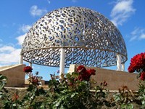
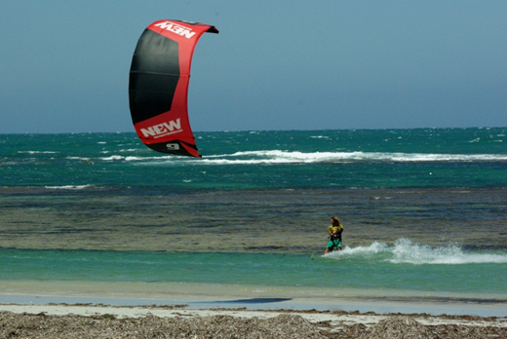
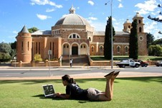
2029 and Beyond
Further Information
Specific reports can be found on the
2029 website
www.2029andbeyond.com.au
CivicEvolution
www.2029.civicevolution.org
Facebook
www.facebook.com (search 2029 and Beyond)
Reinhard Mohn Video
www.linkedin.com/groups/Geraldtons-video-Reinhard-Mohn-Prize-2718371.S.4404586
Big Ideas Festival and OPEN YOUR EYES Festival 2011
http://vimeo.com/29234808
Notes:
To find out more about this project.

